Slide 1
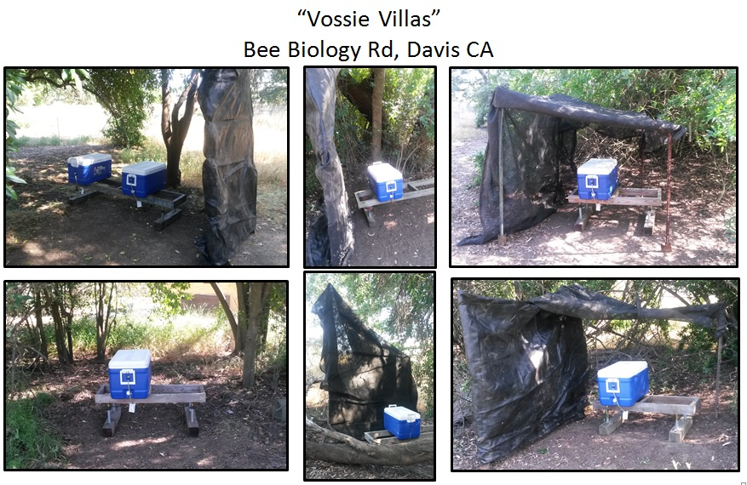
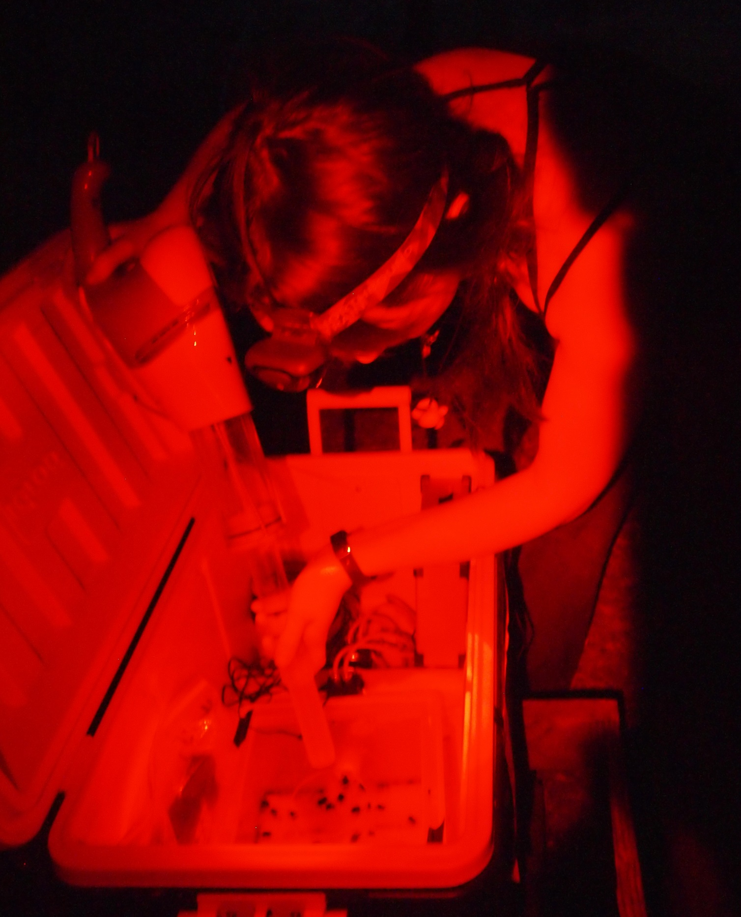
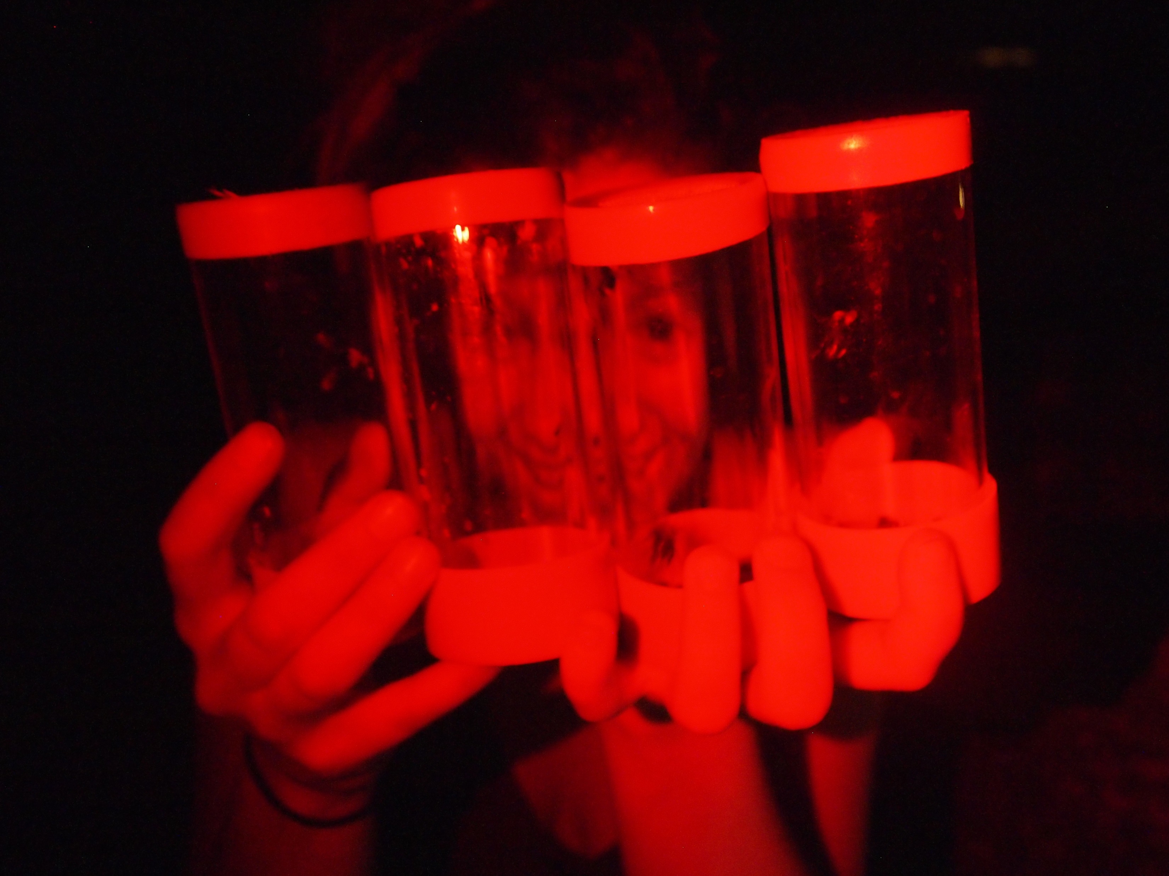
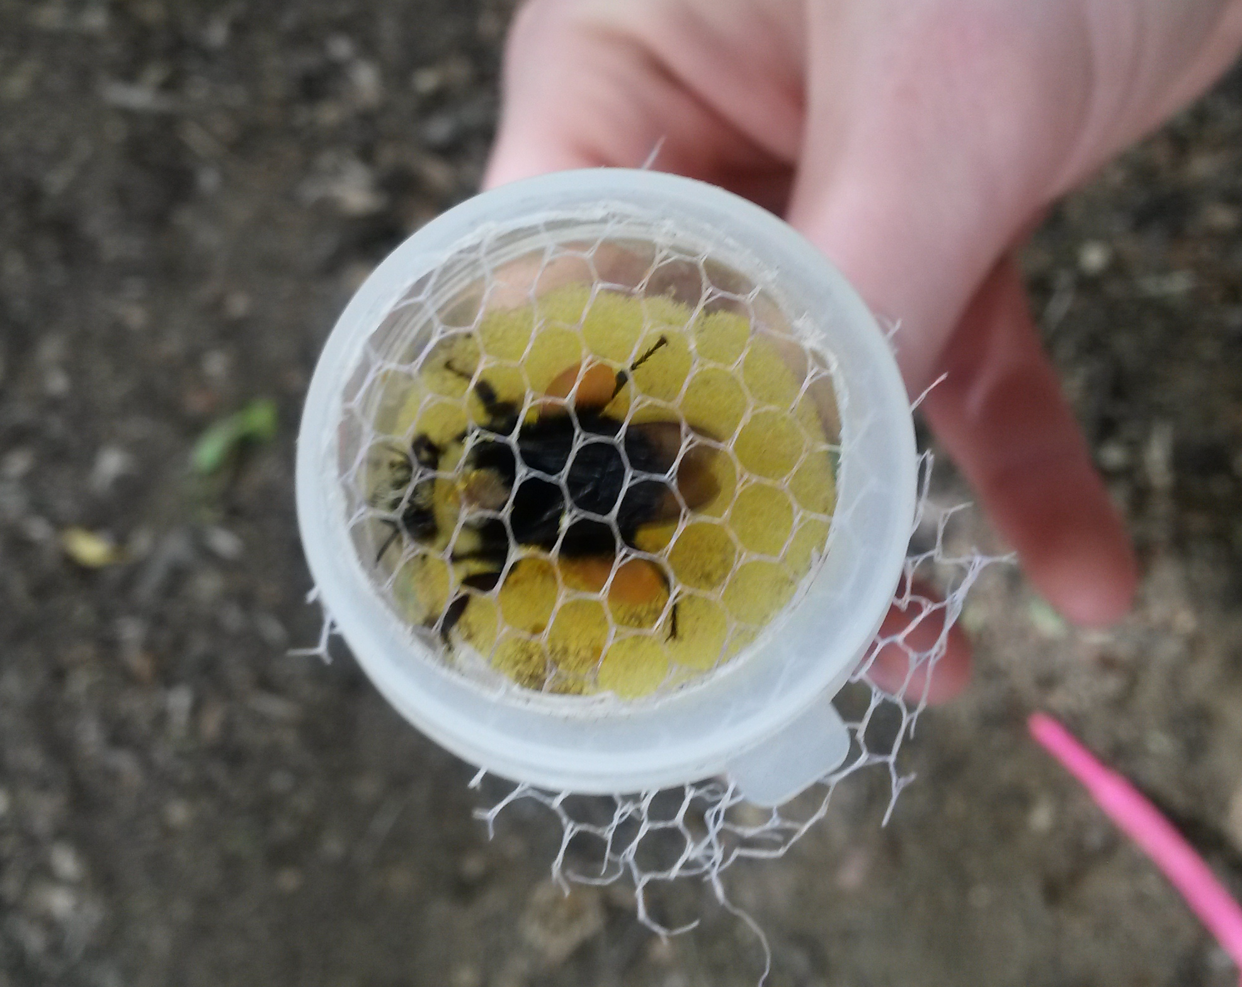
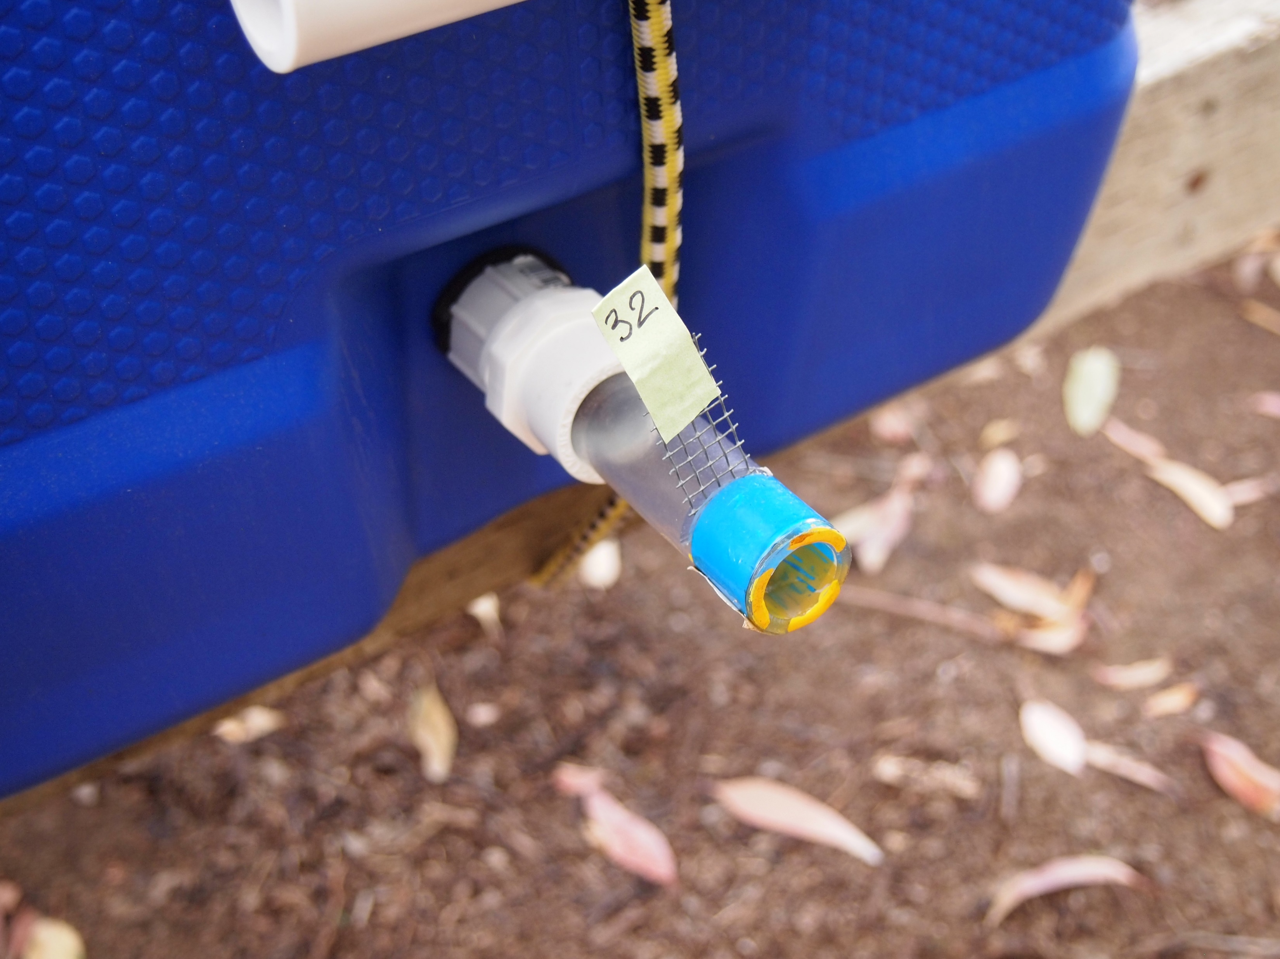
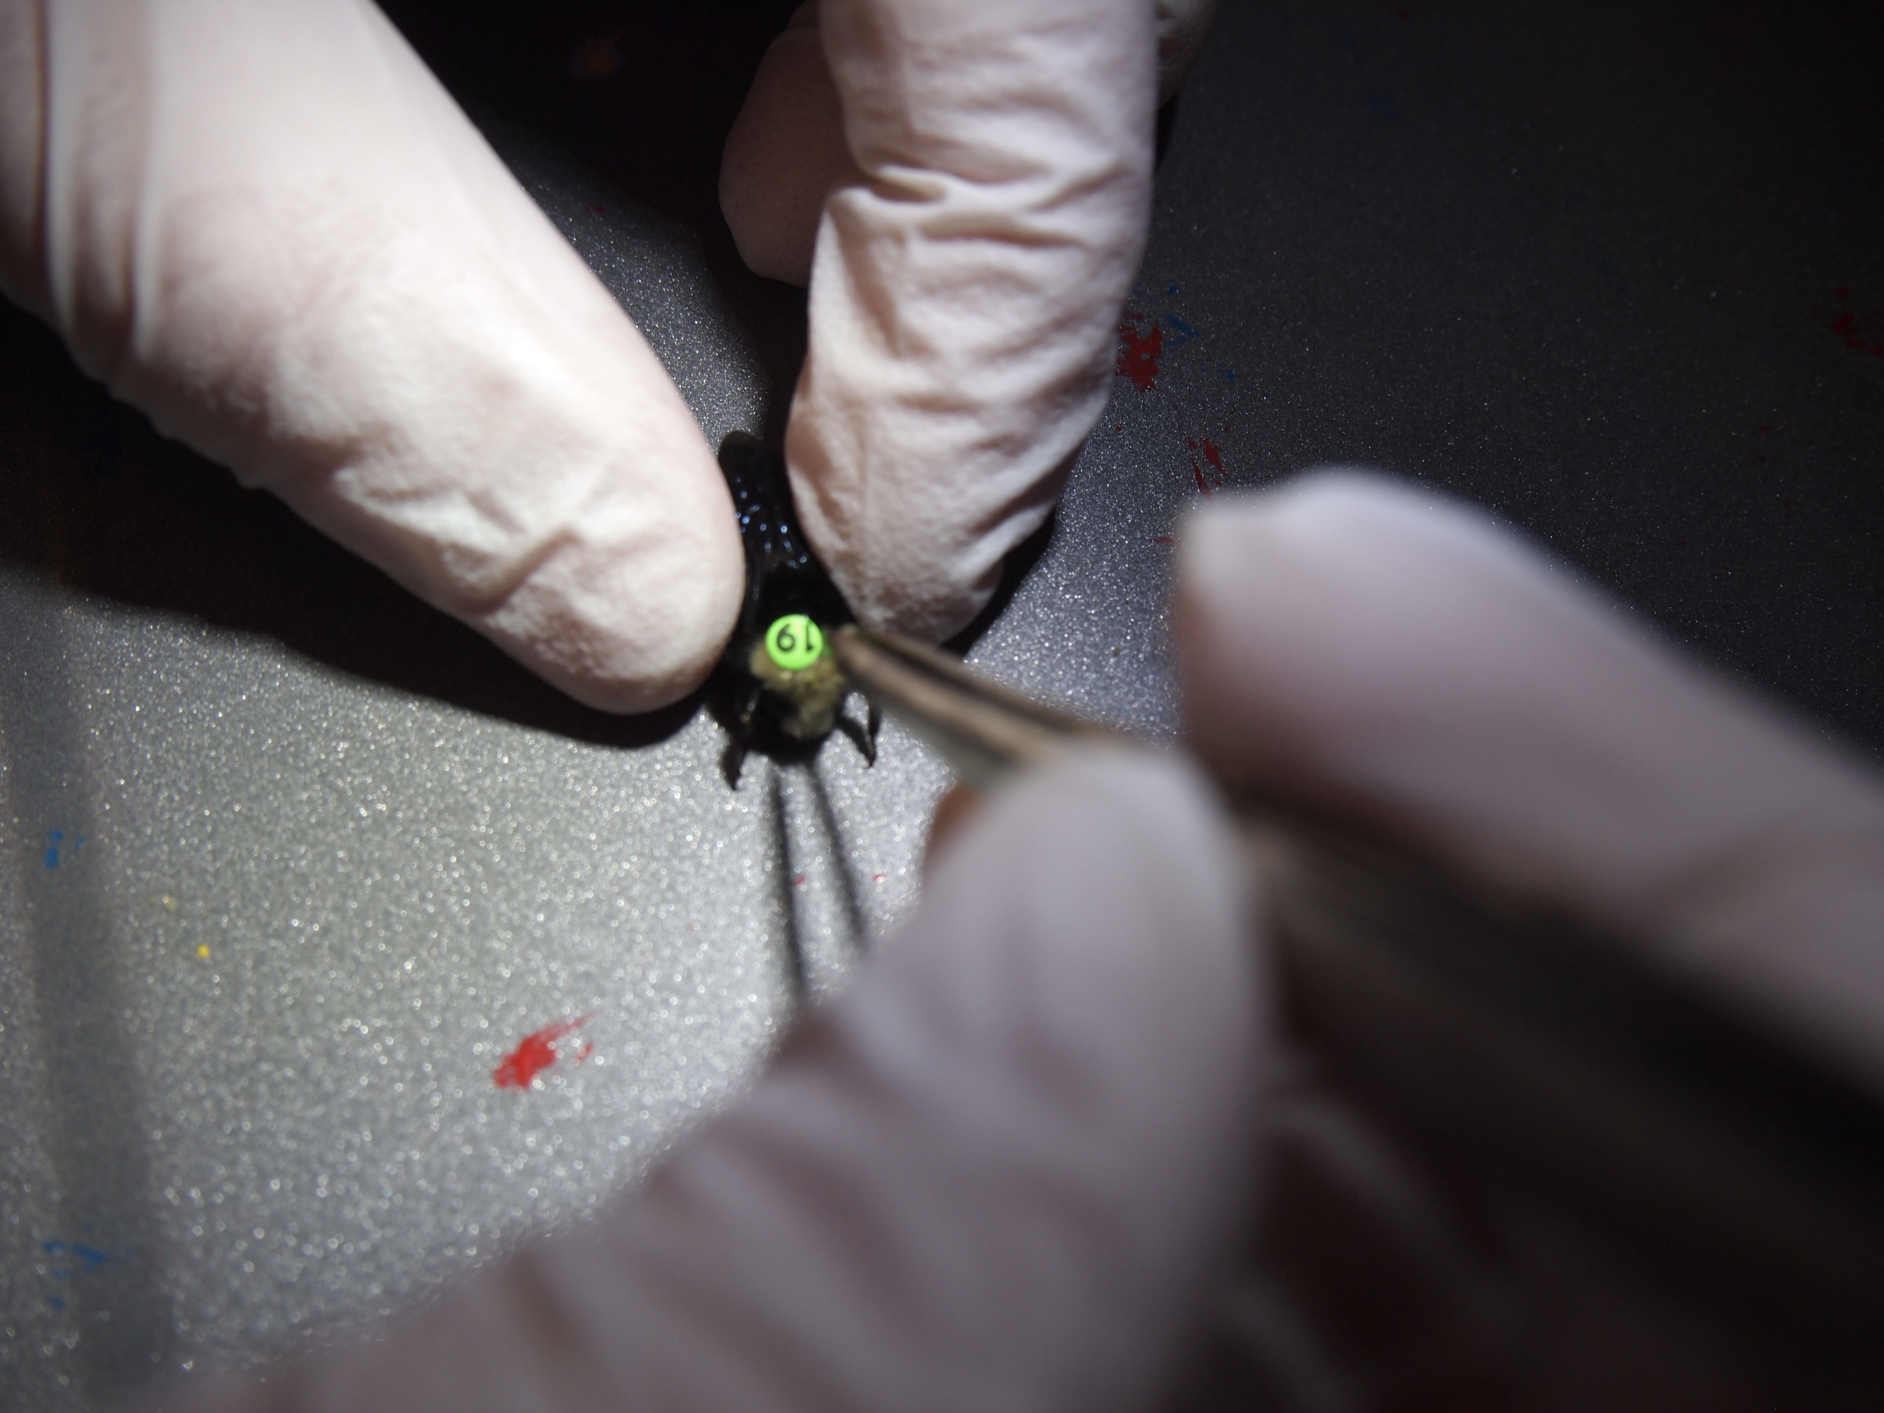
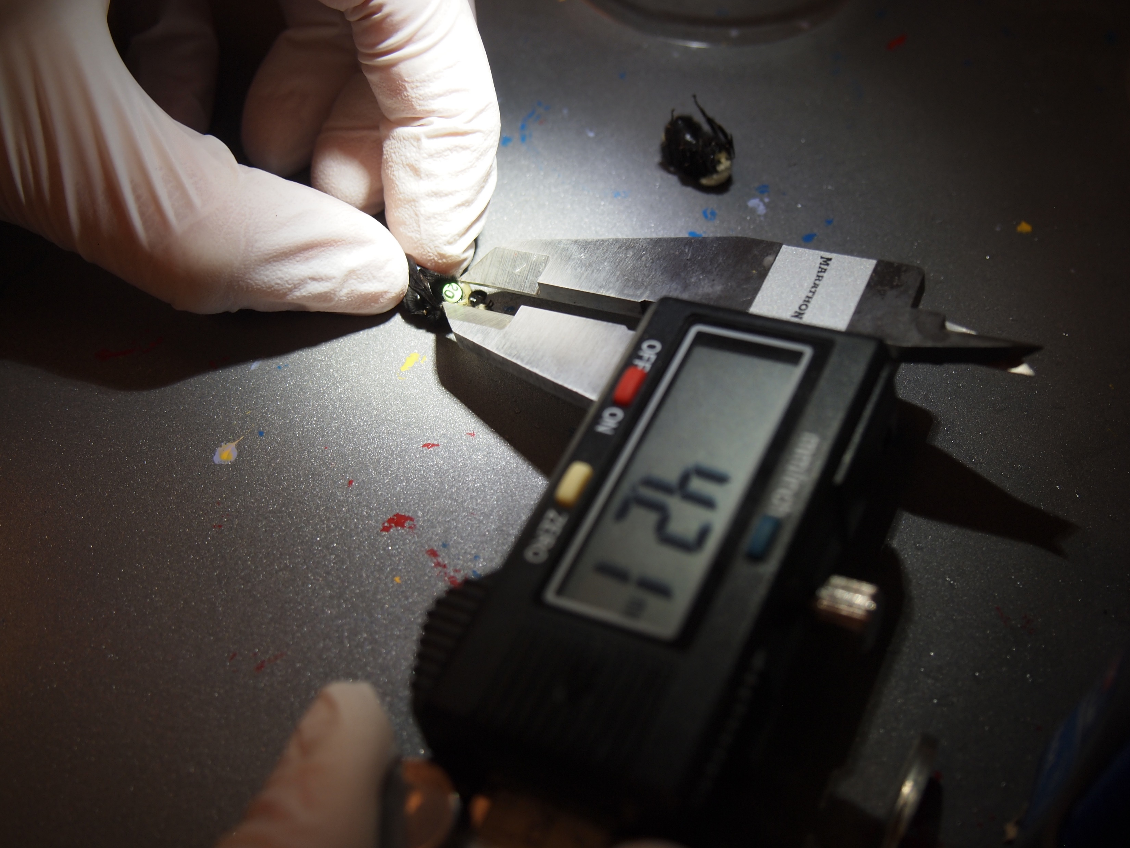
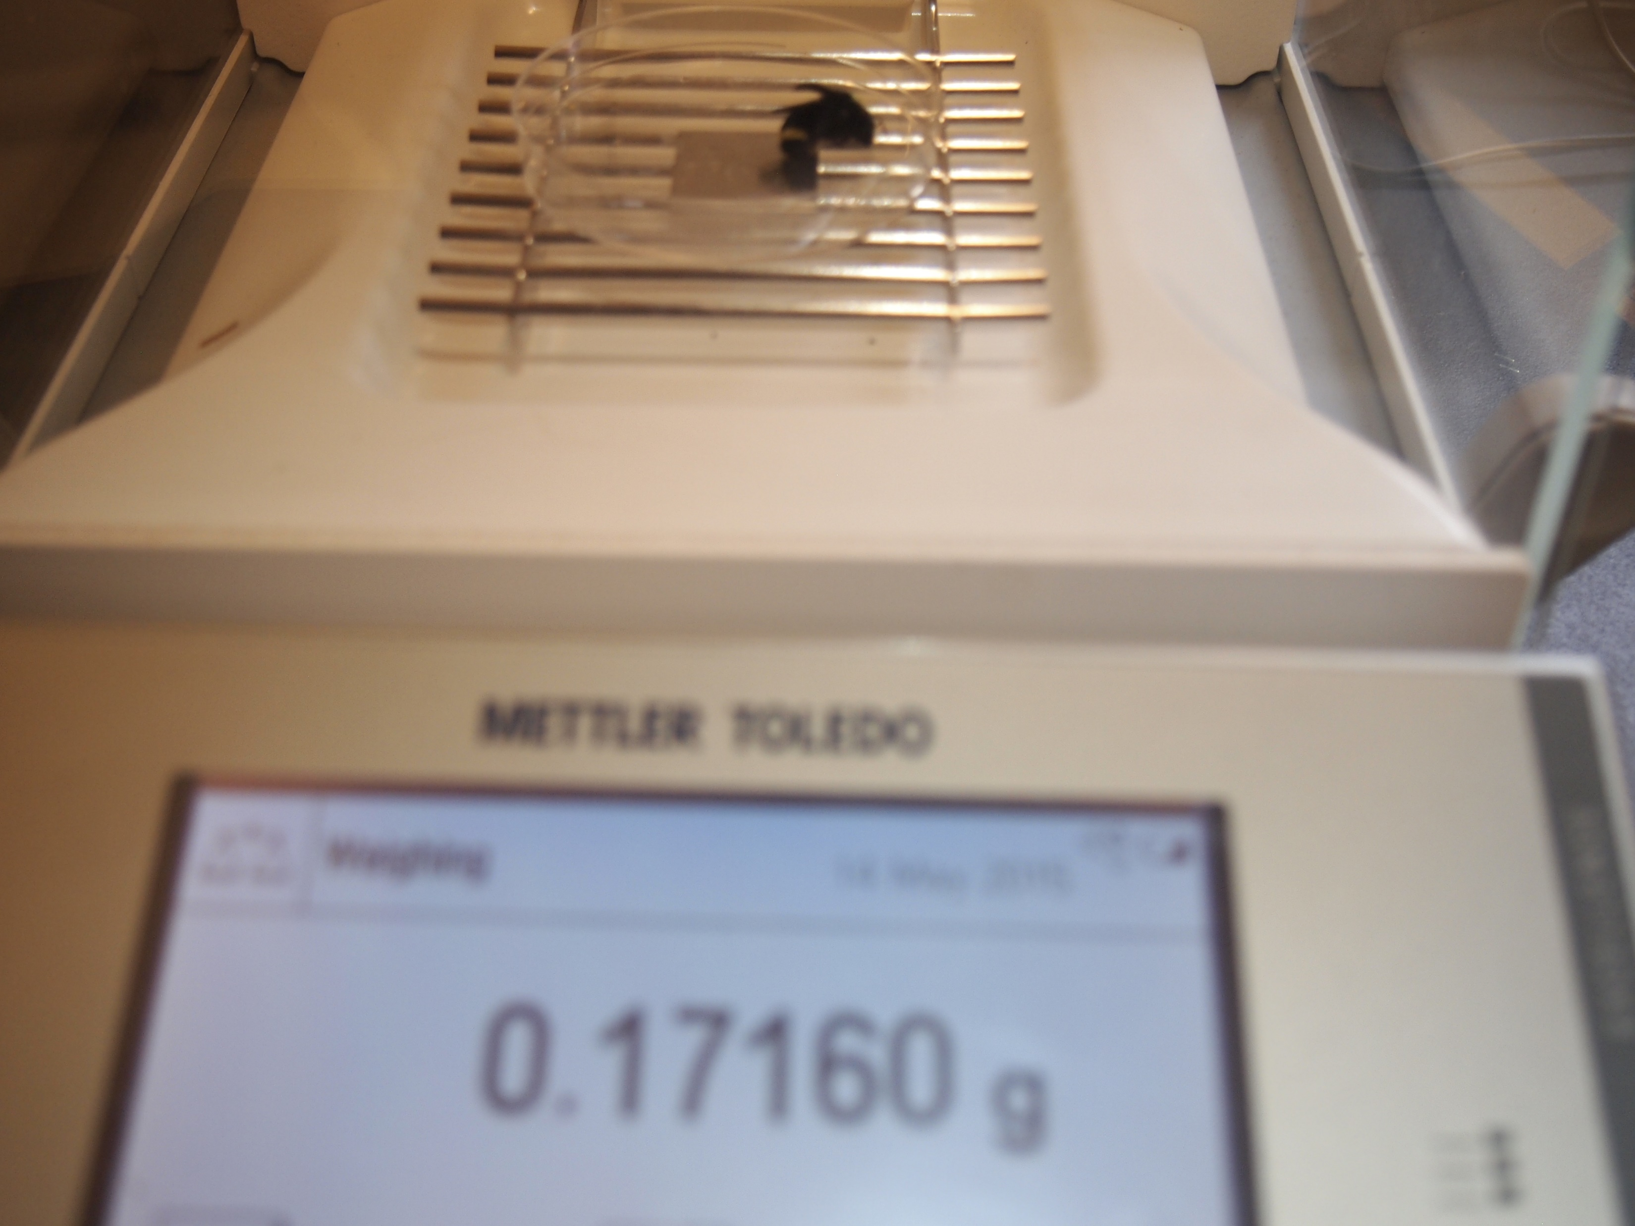
Our data today!
Colony ID: 2, 22, 32, 35, 41, 43, 57, 58

Slide 2
Warmup
Download “BeeNectar.csv” data from Trunk
Create new notebook and save in folder where your data is located.
Read data into R
Calculate summary stats for Nectar column
Mean, medium, IQR, standard deviation, variance
Plot histogram

Slide 3
Exercise 1.
Randomly sample values of “nectar”. Compare the means of the following samples with the population, n = 525.
Mean and standard deviation when sampling, n=10
Mean and standard deviation when sampling, n=40
Instead, find a function (or combination of functions) that will randomly sample rows from the full dataset.

Slide 4
Exercise 2.
Calculate summary statistics for pollen weight and body size (ITS).
Create three separate boxplots of …
Nectar weights for each colony.
Pollen weights for each colony
Body size (ITS) for each colony.
Advanced problem:
Install tidyverse package and then load into R using library(tidyverse).
Use dplyr cheatsheet (in R help tab) to calculate mean and standard deviation of nectar and pollen weight by colony.

